Slide 1
Data concurrency and locking
IBM Information Management Cloud Computing Center of Competence IBM Canada Labs
1

Slide 2
Agenda
Transactions
Concurrency & Locking
Lock Wait
Deadlocks
2

Slide 3
Supporting reading material & videos
Reading materials
Getting started with DB2 Express-C eBook
Chapter 13: Concurrency and locking
Videos
db2university.com course AA001EN
Lesson 8: Data concurrency and locking
3

Slide 4
Agenda
Transactions
Concurrency & Locking
Lock Wait
Deadlocks
4

Slide 5
What is a transaction?
Your bank account
Your Mom’s bank account
Balance = $1000
Balance = $200
Transfer $100 from your account to your Mom’s account:
Debit $100 from your bank account (Subtract $100)
Credit $100 to your mom's bank account (Add $100)
5

Slide 6
What is a transaction? (cont'd)
One or more SQL statements altogether treated as one single unit
Also known as a Unit of Work (UOW)
A transaction starts with any SQL statement and ends with a COMMIT or ROLLBACK
COMMIT statement makes changes permanent to the database
ROLLBACK statement reverses changes
COMMIT and ROLLBACK statements release all locks
6

Slide 7
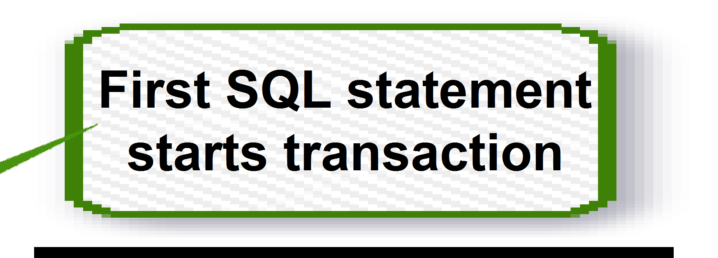



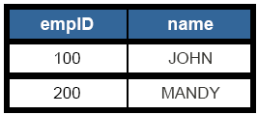

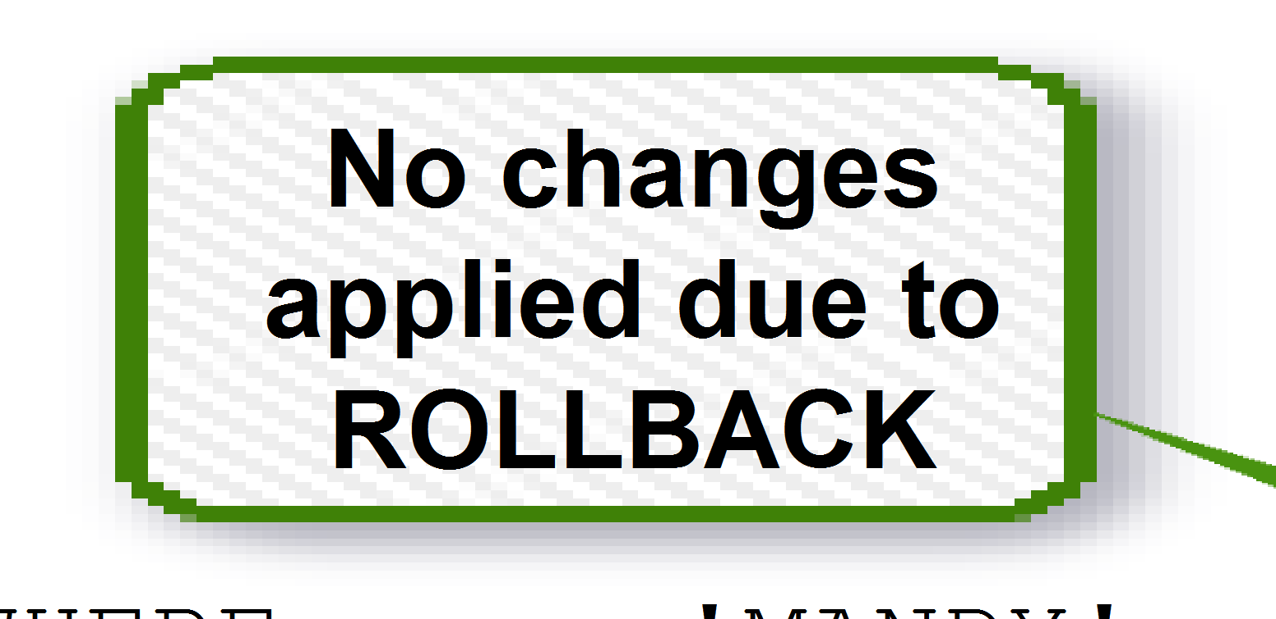

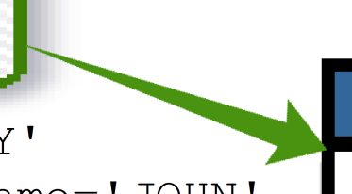
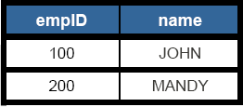

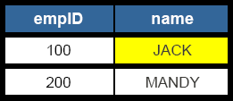




Example of transactions
F
)
irst SQL st
starts trans
atement
action
INSERT INTO employee VALUES (100, 'JOHN' INSERT INTO employee VALUES (200, 'MANDY') COMMIT
No chang
applied du ROLLBAC
es
e to K
DELETE FROM employee WHERE name='MAND
UPDATE employee SET empID=101 where name='JOHN' ROLLBACK
Y'
UPDATE employee SET name='JACK' where empID=100 COMMIT
ROLLBACK
There is not
rollbac
hing to
k
7

Slide 8
Transactions – ACID rules
Atomicity
All statements in the transaction are treated as a unit.
If the transaction completes successfully, everything is committed
If the transaction fails, everything done up to the point of failure is rolled back.
Consistency
Any transaction will take the data from one consistent state to another, so only valid consistent data is stored in the database
Isolation
Concurrent transactions cannot interfere with each other
Durability
Committed transactions have their changes persisted in the database
8

Slide 9
Agenda
Transactions
Concurrency & Locking
Lock Wait
Deadlocks
9

Slide 10
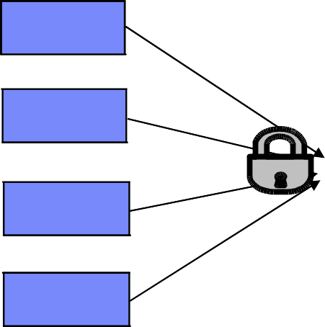
Concurrency and Locking
App A
App B
App C App D
Concurrency:
Multiple users accessing the same resources at the same time
Locking:
Mechanism to ensure data integrity and consistency
ID | Name | Age
3 | Peter | 33
5 | John | 23
22 | Mary | 22
35 | Ann | 55

Slide 11
Locking
Locks are acquired automatically as needed to support a transaction based on “isolation levels”
COMMIT and ROLLBACK statements release all locks
Two basic types of locks:
Share locks (S locks) – acquired when an application wants to read and prevent others from updating the same row
Exclusive locks (X locks) – acquired when an application updates, inserts, or deletes a row

Slide 12
Problems if there is no concurrency control
Lost update
Uncommitted read
Non-repeatable read
Phantom read

Slide 13




Lost update
reservations
seat | name | ...
7C
7B
...
App A
App B

Slide 14
Lost update
reservations
seat | name | ...
7C
7B
...
App A
App B
update reservations set name = 'John' where seat = '7C'

Slide 15
Lost update
reservations
seat | name | ...
7C | John
7B
...
_____
App A
App B
update reservations set name = 'John' where seat = '7C'

Slide 16
Lost update
reservations
seat | name | ...
7C | John
7B
...
_____
App A
App B
update reservations set name = 'John' where seat = '7C'
update reservations set name = 'Mary' where seat = '7C'

Slide 17
Lost update
reservations
seat | name | ...
7C | Mary
7B
...
_____
John
App A
App B
update reservations set name = 'John' where seat = '7C'
update reservations set name = 'Mary' where seat = '7C'

Slide 18
Lost update
reservations
seat | name | ...
7C | M?ary
7B
...
_____
John
App A
App B
update reservations set name = 'John' where seat = '7C'
update reservations set name = 'Mary' where seat = '7C'

Slide 19
Uncommitted read (also known as “dirty read”)
reservations
seat | name | ...
7C
7B
...
App A
App B

Slide 20
Uncommitted read (also known as “dirty read”)
reservations
seat | name | ...
7C
7B
...
App A
App B
update reservations set name = 'John' where seat = '7C'

Slide 21
Uncommitted read (also known as “dirty read”)
reservations
seat | name | ...
7C | John
7B
...
_____
App A
App B
update reservations set name = 'John' where seat = '7C'

Slide 22
Uncommitted read (also known as “dirty read”)
reservations
seat | name | ...
7C | John
7B
...
_____
App A
App B
update reservations set name = 'John' where seat = '7C'
Select name
from reservations where seat is '7C'

Slide 23
Uncommitted read (also known as “dirty read”)
reservations
seat | name | ...
7C | John
7B
...
_____
App A
App B
update reservations set name = 'John' where seat = '7C'
Select name
from reservations where seat is '7C'
John

Slide 24
Uncommitted read (also known as “dirty read”)
reservations
seat | name | ...
7C | John
7B
...
_____
App A
App B
update reservations set name = 'John' where seat = '7C'
Roll back
Select name
from reservations where seat is '7C'
John

Slide 25
Uncommitted read (also known as “dirty read”)
reservations
seat | name | ...
7C
7B
...
App A
App B
update reservations set name = 'John' where seat = '7C'
Roll back
Select name
from reservations where seat is '7C'
John

Slide 26
Uncommitted read (also known as “dirty read”)
reservations
seat | name | ...
7C
7B
...
App A
App B
update reservations set name = 'John' where seat = '7C'
Roll back
Select name
from reservations where seat is '7C'
John
Further processing in Ap B uses incorrect / uncommitted value of “John”
p

Slide 27
Non-repeatable read
reservations
seat | name | ...
7C
7B
...
App A
App B

Slide 28
Non-repeatable read
reservations
seat | name | ...
7C
7B
...
App A
App B
select seat
from reservations where name is NULL

Slide 29
Non-repeatable read
reservations
seat | name | ...
7C
7B
...
App A
App B
select seat
from reservations where name is NULL
7C
7B

Slide 30
Non-repeatable read
reservations
seat | name | ...
7C
7B
...
App A
App B
select seat
from reservations where name is NULL
update reservations set name = 'John' where seat = '7C'
7C
7B

Slide 31
Non-repeatable read
reservations
seat | name | ...
7C | John
7B
...
_____
App A
App B
select seat
from reservations where name is NULL
update reservations set name = 'John' where seat = '7C'
7C
7B

Slide 32
Non-repeatable read
reservations
seat | name | ...
7C | John
7B
...
_____
App A
App B
select seat
from reservations where name is NULL
...
select seat
from reservations where name is NULL
update reservations set name = 'John' where seat = '7C'
7C
7B

Slide 33
Non-repeatable read
reservations
seat | name | ...
7C | John
7B
...
_____
App A
App B
select seat
from reservations where name is NULL
...
select seat
from reservations where name is NULL
update reservations set name = 'John' where seat = '7C'
7C
7B
7B

Slide 34
Non-repeatable read
reservations
seat | name | ...
7C | John
7B
...
_____
App A
App B
update reservations set name = 'John' where seat = '7C'
7C
select seat
from reservations where name is NULL
...
7B
The same SELECT (read) returns a
select seat
from reservations where name is NULL
different result: Less rows (in this
7B
case '7C' doesn't show anymore).
This is a non-repeatable read

Slide 35
Phantom read
reservations
seat | name | ...
7C | Susan
7B
...
_____
App A
App B

Slide 36
Phantom read
reservations
seat | name | ...
7C | Susan
7B
...
_____
App A
App B
select seat
from reservations where name is NULL

Slide 37
Phantom read
reservations
seat | name | ...
7C | Susan
7B
...
_____
App A
App B
select seat
from reservations where name is NULL
7B

Slide 38
Phantom read
reservations
seat | name | ...
7C | Susan
7B
...
_____
App A
App B
select seat
from reservations where name is NULL
update reservations set name = NULL where seat = '7C'
7B

Slide 39
Phantom read
reservations
seat | name | ...
7C
7B
...
App A
App B
select seat
from reservations where name is NULL
update reservations set name = NULL where seat = '7C'
7B

Slide 40
Phantom read
reservations
seat | name | ...
7C
7B
...
App A
App B
select seat
from reservations where name is NULL
...
select seat
from reservations where name is NULL
update reservations set name = NULL where seat = '7C'
7B

Slide 41
Phantom read
reservations
seat | name | ...
7C
7B
...
App A
App B
select seat
from reservations where name is NULL
...
select seat
from reservations where name is NULL
update reservations set name = NULL where seat = '7C'
7B
7C
7B

Slide 42
Phantom read
reservations
seat | name | ...
7C
7B
...
App A
App B
update reservations set name = NULL where seat = '7C'
select seat
from reservations where name is NULL
7B
...
select seat
from reservations
The same SELECT (read) returns a different result: More rows (phantom rows, in this case '7C', is shown)
This is a phantom read
7C
7B
where name is NULL

Slide 43
Isolation levels
“Policies” to control when locks are taken
DB2 provides different levels of protection to isolate data
Uncommitted Read (UR)
Cursor Stability (CS)
Currently committed (CC)
Read Stability (RS)
Repeatable Read (RR)

Slide 44
Setting the isolation levels
Isolation level can be specified at many levels
Session (application),
Connection,
Statement
For statement level, use the WITH {RR, RS, CS, UR} clause:
SELECT COUNT(*) FROM tab1 WITH UR
For embedded SQL, the level is set at bind time
For dynamic SQL, the level is set at run time

Slide 45
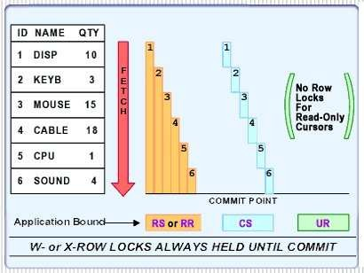
Comparing isolation levels

Slide 46
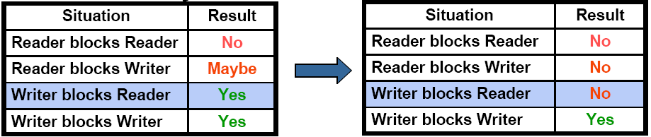
Cursor stability with currently committed (CC) semantics
Cursor stability with currently committed semantics is the default isolation level
Use cur_commit db cfg parameter to enable/disable
Avoids timeouts and deadlocks
Cursor stability with currently committed
Cursor stability

Slide 47
Cursor stability with currently committed (CC) semantics
Cursor stability without currently committed
reservations
App A App B
seat | name | ...
7C | Susan
7B
...
Cursor stability with currently committed (Default behavior)
reservations
App A App B
seat | name | ...
7C | Susan
7B
...

Slide 48
Cursor stability with currently committed (CC) semantics
Cursor stability without currently committed
reservations
App A App B
seat | name | ...
7C | Susan
7B
...
update
reservations
set name = 'John' where seat = '7C'
_{X}
Cursor stability with currently committed (Default behavior)
reservations
App A App B
seat | name | ...
7C | Susan
7B
...

Slide 49
Cursor stability with currently committed (CC) semantics
Cursor stability without currently committed
reservations
App A App B
seat | name | ...
7C | John
7B
...
update
reservations
set name = 'John' where seat = '7C'
_{X}
Susan
Cursor stability with currently committed (Default behavior)
reservations
App A App B
seat | name | ...
7C | Susan
7B
...

Slide 50
Cursor stability with currently committed (CC) semantics
Cursor stability without currently committed
reservations
App A App B
seat | name | ...
7C | John
7B
...
update
reservations
set name = 'John' where seat = '7C'
_{X}
select name
from reservations where seat = '7C'
Susan
S
Cursor stability with currently committed (Default behavior)
reservations
App A App B
seat | name | ...
7C | Susan
7B
...

Slide 51
Cursor stability with currently committed (CC) semantics
Cursor stability without currently committed
reservations
App A
seat | name | ...
7C | John
7B
...
Lock Wait
App B
update
reservations
set name = 'John' where seat = '7C'
_{X}
select name
from reservations where seat = '7C'
Susan
S
Cursor stability with currently committed (Default behavior)
reservations
App A App B
seat | name | ...
7C | Susan
7B
...

Slide 52
Cursor stability with currently committed (CC) semantics
Cursor stability without currently committed
reservations
App A
update
seat
name
...
Lock Wait
App B
_{X}
select name
7C
John
S
Susan
reservations
set name = 'John' where seat = '7C'
from reservations where seat = '7C'
7B
...
App B hangs until App A commits or rolls back which releases X lock
Cursor stability with currently committed (Default behavior)
reservations
App A App B
seat | name | ...
7C | Susan
7B
...

Slide 53
Cursor stability with currently committed (CC) semantics
Cursor stability without currently committed
reservations
App A
update
seat
name
...
Lock Wait
App B
_{X}
select name
7C
John
S
Susan
reservations
set name = 'John' where seat = '7C'
from reservations where seat = '7C'
7B
...
App B hangs until App A commits or rolls back which releases X lock
Cursor stability with currently committed (Default behavior)
reservations
App A App B
seat | name | ...
7C | Susan
7B
...
update
reservations
set name = 'John' where seat = '7C'
_{X}

Slide 54
Cursor stability with currently committed (CC) semantics
Cursor stability without currently committed
reservations
App A
update
seat
name
...
Lock Wait
App B
_{X}
select name
7C
John
S
Susan
reservations
set name = 'John' where seat = '7C'
from reservations where seat = '7C'
7B
...
App B hangs until App A commits or rolls back which releases X lock
Cursor stability with currently committed (Default behavior)
reservations
App A App B
seat | name | ...
7C | John
7B
...
update
reservations
set name = 'John' where seat = '7C'
_{X}
Susan

Slide 55
Cursor stability with currently committed (CC) semantics
Cursor stability without currently committed
reservations
App A
update
seat
name
...
Lock Wait
App B
_{X}
select name
7C
John
S
Susan
reservations
set name = 'John' where seat = '7C'
from reservations where seat = '7C'
7B
...
App B hangs until App A commits or rolls back which releases X lock
Cursor stability with currently committed (Default behavior)
reservations
App A App B
seat | name | ...
7C | John
7B
...
update
reservations
set name = 'John' where seat = '7C'
_{X}
select name
from reservations where seat = '7C'
Susan
S

Slide 56
Cursor stability with currently committed (CC) semantics
Cursor stability without currently committed
reservations
App A
update
seat
name
...
Lock Wait
App B
_{X}
select name
7C
John
S
Susan
reservations
set name = 'John' where seat = '7C'
from reservations where seat = '7C'
7B
...
App B hangs until App A commits or rolls back which releases X lock
Cursor stability with currently committed (Default behavior)
reservations
App A
update
seat
name
...
App B
_{X}
select name
7C
John
S
Susan
reservations
set name = 'John' where seat = '7C'
from reservations where seat = '7C'
7B
...
App B retrieves currently committed value of 'Susan'

Slide 57
Comparing and choosing an isolation level
Isolation Level | Lost update | Dirty Read | Non-repeatable Read | Phantom Read
Repeatable Read (RR) | - | - | - | -
ReadStability (RS) | - | - | - | Possible
Cursor Stability (CS) | - | - | Possible | Possible
Uncommitted Read (UR) | - | Possible | Possible | Possible
Application Type | High data stability required | High data stability not required
Read-write transactions | RS | CS
Read-only transactions | RS or RR | UR

Slide 58
Agenda
Transactions
Concurrency & Locking
Lock Wait
Deadlocks

Slide 59
Lock wait
By default, an application waits indefinitely to obtain any needed locks
LOCKTIMEOUT (db cfg):
Specifies the number of seconds to wait for a lock
Default value is -1 or infinite wait
Example: (Same as when using isolation CS without CC):
reservations
App A
seat | name | ...
7C | Susan
7B
...
App B

Slide 60
Lock wait
By default, an application waits indefinitely to obtain any needed locks
LOCKTIMEOUT (db cfg):
Specifies the number of seconds to wait for a lock
Default value is -1 or infinite wait
Example: (Same as when using isolation CS without CC):
reservations
App A
seat | name | ...
7C | Susan
7B
...
App B
update
reservations
set name = 'John' where seat = '7C'
_{X}

Slide 61
Lock wait
By default, an application waits indefinitely to obtain any needed locks
LOCKTIMEOUT (db cfg):
Specifies the number of seconds to wait for a lock
Default value is -1 or infinite wait
Example: (Same as when using isolation CS without CC):
reservations
App A
seat | name | ...
7C | John
7B
...
App B
update
reservations
set name = 'John' where seat = '7C'
_{X}
Susan

Slide 62
Lock wait
By default, an application waits indefinitely to obtain any needed locks
LOCKTIMEOUT (db cfg):
Specifies the number of seconds to wait for a lock
Default value is -1 or infinite wait
Example: (Same as when using isolation CS without CC):
reservations
App A
seat | name | ...
7C | John
7B
...
App B
update
reservations
set name = 'John' where seat = '7C'
_{X}
select name
from reservations where seat = '7C'
Susan
S

Slide 63
Lock wait
By default, an application waits indefinitely to obtain any needed locks
LOCKTIMEOUT (db cfg):
Specifies the number of seconds to wait for a lock
Default value is -1 or infinite wait
Example: (Same as when using isolation CS without CC):
reservations
App A
seat | name | ...
7C | John
7B
...
Lock Wait
App B
update
reservations
set name = 'John' where seat = '7C'
_{X}
select name
from reservations where seat = '7C'
Susan
S

Slide 64
Lock wait
By default, an application waits indefinitely to obtain any needed locks
LOCKTIMEOUT (db cfg):
Specifies the number of seconds to wait for a lock
Default value is -1 or infinite wait
Example: (Same as when using isolation CS without CC):
reservations
App A
seat | name | ...
7C | John
7B
...
Lock Wait
App B
update
reservations
set name = 'John' where seat = '7C'
_{X}
select name
from reservations where seat = '7C'
Susan
S
App B waits “LOCKTIMEOUT” seconds to get 'S' lock on first row

Slide 65
Agenda
Transactions
Concurrency & Locking
Lock Wait
Deadlocks

Slide 66
Deadlocks
Occurs when two or more applications wait indefinitely for a resource
Each application is holding a resource that the other needs
Waiting is never resolved
In the example, assume we are using isolation CS without CC
reservations
App A App B
seat | name | ...
7C | Susan
7B
...
8E | Raul
9F | Jin

Slide 67
Deadlocks
Occurs when two or more applications wait indefinitely for a resource
Each application is holding a resource that the other needs
Waiting is never resolved
In the example, assume we are using isolation CS without CC
reservations
App A App B
seat | name | ...
7C | Susan
7B
...
8E | Raul
9F | Jin
update
reservations
set name = 'John' where seat = '7C'
_{X}

Slide 68
Deadlocks
Occurs when two or more applications wait indefinitely for a resource
Each application is holding a resource that the other needs
Waiting is never resolved
In the example, assume we are using isolation CS without CC
reservations
App A App B
seat | name | ...
7C | John
7B
...
8E | Raul
9F | Jin
update
reservations
set name = 'John' where seat = '7C'
_{X}
Susan

Slide 69
Deadlocks
Occurs when two or more applications wait indefinitely for a resource
Each application is holding a resource that the other needs
Waiting is never resolved
In the example, assume we are using isolation CS without CC
reservations
App A App B
seat | name | ...
7C | John
7B
...
8E | Raul
9F | Jin
update
reservations
set name = 'John' where seat = '7C'
_{X}
update
reservations
set name = 'Sue' where seat = '9F'
Susan
X

Slide 70
Deadlocks
Occurs when two or more applications wait indefinitely for a resource
Each application is holding a resource that the other needs
Waiting is never resolved
In the example, assume we are using isolation CS without CC
reservations
App A App B
seat | name | ...
7C | John
7B
...
8E | Raul
9F | Sue
update
reservations
set name = 'John' where seat = '7C'
_{X}
update
reservations
set name = 'Sue' where seat = '9F'
Susan
Jin
X

Slide 71
Deadlocks
Occurs when two or more applications wait indefinitely for a resource
Each application is holding a resource that the other needs
Waiting is never resolved
In the example, assume we are using isolation CS without CC
reservations
App A App B
seat | name | ...
7C | John
7B
...
8E | Raul
9F | Sue
update
reservations
set name = 'John' where seat = '7C'
...
select name
from reservations where seat = '9F'
_{X}
update
reservations
set name = 'Sue' where seat = '9F'
Susan
S
Jin
X

Slide 72
Deadlocks
Occurs when two or more applications wait indefinitely for a resource
Each application is holding a resource that the other needs
Waiting is never resolved
In the example, assume we are using isolation CS without CC
reservations
App A App B
seat | name | ...
7C | John
7B
...
8E | Raul
9F | Sue
update
reservations
set name = 'John' where seat = '7C'
...
select name
from reservations where seat = '9F'
_{X}
update
reservations
set name = 'Sue' where seat = '9F'
Susan
S
Jin
X
Lock Wait

Slide 73
Deadlocks
Occurs when two or more applications wait indefinitely for a resource
Each application is holding a resource that the other needs
Waiting is never resolved
In the example, assume we are using isolation CS without CC
reservations
App A App B
seat | name | ...
7C | John
7B
...
8E | Raul
9F | Sue
update
reservations
set name = 'John' where seat = '7C'
...
select name
from reservations where seat = '9F'
_{X}
update
reservations
set name = 'Sue' where seat = '9F'
...
select name
from reservations where seat = '7C'
Susan
S
S
Jin
X
Lock Wait

Slide 74
Deadlocks
Occurs when two or more applications wait indefinitely for a resource
Each application is holding a resource that the other needs
Waiting is never resolved
In the example, assume we are using isolation CS without CC
reservations
App A App B
seat | name | ...
7C | John
7B
...
8E | Raul
9F | Sue
Lock Wait
S
update
reservations
set name = 'John' where seat = '7C'
...
select name
from reservations where seat = '9F'
_{X}
update
reservations
set name = 'Sue' where seat = '9F'
...
select name
from reservations where seat = '7C'
Susan
S
Jin
X
Lock Wait

Slide 75
Deadlocks
Occurs when two or more applications wait indefinitely for a resource
Each application is holding a resource that the other needs
Waiting is never resolved
In the example, assume we are using isolation CS without CC
reservations
App A App B
seat
name
...
Lock Wait
S
update
reservations
set name = 'John' where seat = '7C'
...
select name
from reservations where seat = '9F'
_{X}
update
reservations
set name = 'Sue' where seat = '9F'
...
select name
from reservations where seat = '7C'
7C
John
Susan
7B
...
8E
Raul
9F
Sue
X
S
Jin
Lock Wait
Deadlo
ck!

Slide 76
Deadlocks
Deadlocks are commonly caused by poor application design
DB2 provides a deadlock detector
– Use DLCHKTIME (db cfg) to set the time interval for checking for deadlocks
– When a deadlock is detected, DB2 uses an internal algorithm to pick which transaction to roll back, and which one to continue.
– The transaction that is forced to roll back gets a SQL error. The rollback causes all of its locks to be released

Slide 77

Thank you!
77 © 2011 IBM Corporation

